Slide 1
Builder Pattern

Slide 2
Gang OF Four
The 23 Gang of Four (GoF) patterns are generally considered the foundation for all other patterns. They are categorized in three groups: Creational, Structural, and Behavioral

Slide 3
1. Creational Design Patterns
Abstract Factory – Creates an instance of several families of classes.
Builder – Separates object construction from its representation.
Factory Method – Creates an instance of several derived classes.
Prototype – A fully initialized instance to be copied or cloned.
Singleton – A class of which only a single instance can exist.

Slide 4
Structural Design Patterns.
Adapter .
Bridge.
Composite
Decorator
Façade.
Flyweight.
Proxy.

Slide 5
Behavioral Design Patterns
Chain of Responsibility.
Command
Interpreter
Iterator
Mediator
Memeto
Observer
State
Strategy
Visitor
Template Method

Slide 6
Lets jump to Builder Patterns

Slide 7
What is Builder Pattern?
Builder Pattern builds a complex object by using step by step approach.
Builder interface defines the steps to build the final object. This builder is independent from the object creation process.
A Class that is known as “Director”.

Slide 8
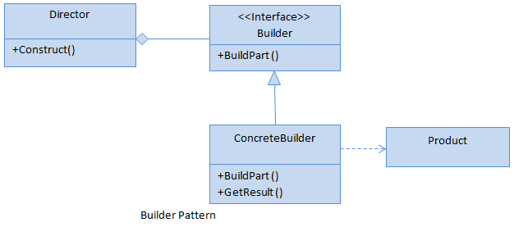
UML Diagram.

Slide 9
Parts of Builder Pattern
Builder – This is an Interface which is used to define all the steps to create a product.
Concrete Builder – This is a class which implements the builder interface to create complex product.
Product – This is al class which defines the parts of the complex object which are to be generated by the builder pattern.
Director – This is a class which is used to construct an object using the Builder Interface.

Slide 10
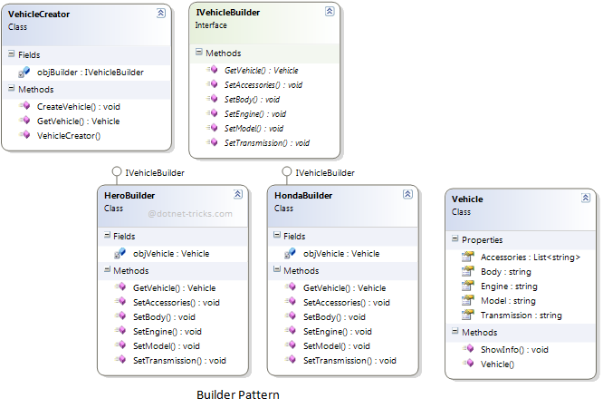
Example – Vehicle Builder

Slide 11
Who is What ?
IVehicleBuilder – Builder Interface.
Hero & Honda Builders – Concrete Builders.
Vehicle – Product.
Vehicle Creator – Director.

Slide 12
Demo.

